Slide 1
Executive Effectiveness:
Notes on Peter Drucker,
The Effective Executive
Phil Pfeiffer
Fall, 2014

Slide 2
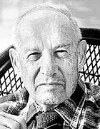
Why Effectiveness Matters
Contemporary society depends on knowledge-based organizations to produce wealth
Producing wealth in such organizations requires
  Meeting present commitments
  Innovating
Doing both well requires time
and discipline
  Urgency of present matters
  a particular concern
Primary source: Peter Drucker, The Effective Executive

Slide 3
Organization for These Notes
Time Management (Chapters 1-2)
Focus (Chapters 3-5)
Decision-Making (Chapters 6-7)

Slide 4
Time Management: The Time Dilemma
The executive's time tends to belong to everybody else…
Everybody can move in on his time, & everybody does…
Small time-wasters abound in the life of every executive … demands that
  add little, if anything, to their productivity, and yet
  cannot be disregarded…
Senior executives rarely have as much as one quarter
of their time truly at their disposal and available for the important matters,
  the matters that contribute,
  the matters they get paid for.

Slide 5
Addressing the Time Dilemma
Drucker's prescription:
Identify where your time goes
Eliminate time-wasting activities
  Heaviest focus: meetings
Consolidate "personal" time into blocks,
large enough to do the hard work

Slide 6
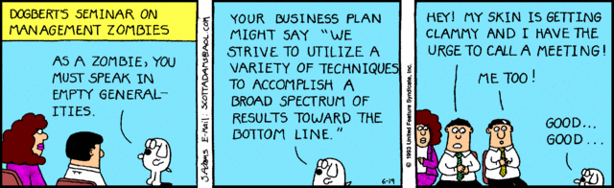
Meetings

Slide 7
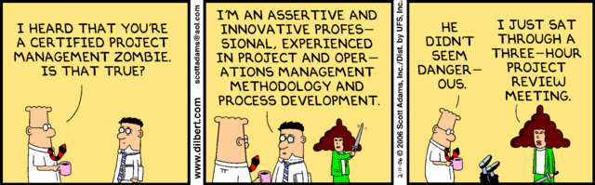
Meetings
By definition, a concession to a deficient organization
  Either one meets or one works
  One cannot do both at the same time
An undirected meeting … is a danger.
Meetings must be the exception rather than the rule.

Slide 8
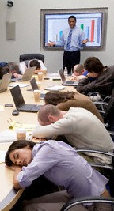
Meetings: 5 Scripts
Press releases
  Prepare in advance
  Have someone disseminate
One announcement or report
  Limit to text, discussion of same
Multiple reports, format 1
  Clarifying questions only
Multiple reports, format 2
  Disseminate reports in advance
  Limit each report to preset time
Informing an executive
  Employees report
  Exec listens, asks questions, summarizes

Slide 9
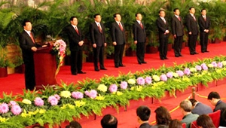
Meetings: to Avoid
Departures from script/ using other "scripts", including
  Bull sessions
  On-the-spot problem solving (e.g., brainstorming)
Rules extend to conversations, which are also meetings
Exception: Ceremony ☹

Slide 10
Other Time-Wasters
Useless obligations
  Fix: learn to say no
HR problems
  Fix: outsource; downsize
Wasting other people's time
  Fix: ask, then respond to suggestions
  Particularly hard: ego involved
Doing work others can do as well, or better
  Fix: delegate
Recurring crises
  Fix: prevent or reduce to routine
Too many cross-group meetings
  Fix: reorganize
Bad information flow
  Fix: diagnose; communicate

Slide 11
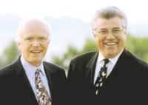
Need for Unimpeded Think Time
Discussed in more
depth in groundbreaking IT-based HR book, Tom DeMarco and Tim Lister's Peopleware (1987)
Concern: achieving flow
  Deep, meditative involvement in work
  Must for design, development, writing, engineering…

Slide 12
Environmental-Factor (E-Factor)
(Uninterrupted/ Body-Present) Hours, where
  Uninterrupted hours =
  time without interruption,
  minus 15 minutes for each interruption
  that kills an uninterrupted block of time
DeMarco and Lister recorded E-factors at U.S. government agencies of between 0.10 and 0.38
"In most of the office space we encounter today, there is enough noise and interruption to make any serious thinking virtually impossible."
This is why I try to work at home.

Slide 13
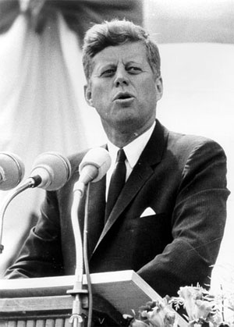
Drucker and Focus on Contribution
A Kennedy-esque view of effectiveness
  Assuming organzations don't owe people jobs
  Looking for ways to contribute
  Looking for ways to help
  others to contribute
Beyond Kennedy
  Focus on contribution meets
  basic requirements of human
  relations: i.e., dialogue,
  teamwork, personal growth
Primary source: Peter Drucker, The Effective Executive

Slide 14
Contribution and Human Relations
Asking subordinates "what can you contribute?" aids communication by creating dialogue
Focusing on effectiveness
leads to coordination with others
Focusing on contribution
leads to development of others (by example)
Focusing on contribution
leads to self-development
  Requires development of skills to make contributions
  People grow according to demands they make on themselves

Slide 15
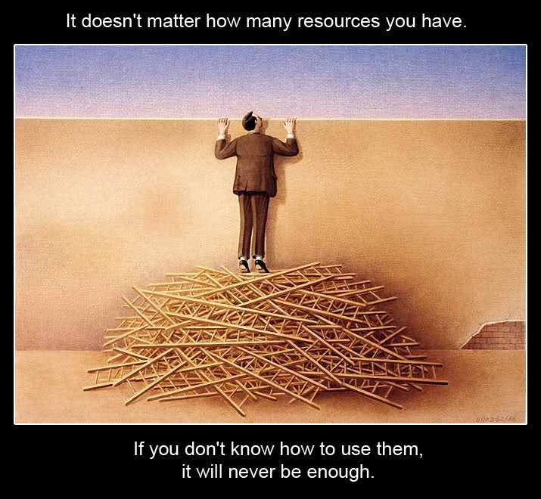
Drucker & Making Strength Productive

Slide 16
Drucker & Making Strength Productive
The myth of "well-roundedness"
  Two mediocrities don't equal one strength
  Strong people have strong weaknesses
    Human excellence can only be in one area,
    or at most a very few
    Excellence typically achieved at cost of weaknesses in other areas
Effective executives play to employees' strengths
  Focus on what they do uncommonly well
  Structure to make strengths relevant
  Tolerate displeasing behavior, if needed

Slide 17
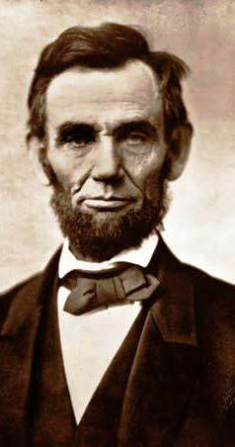
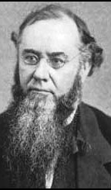
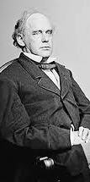
Lincoln, Stanton, and Chase

Slide 18
Balancing Persons, Org. Needs
Redesign jobs that repeatedly defeat those in them
  Examples involve jobs that are too broad
Make jobs demanding and big
  Particularly true for young knowledge workers,
  so as to avoid boredom, premature burnout
Put effort into discovering people's strengths and matching them to the required jobs. Recommended:
  What does a person do well?
  What is a person likely to be able to do well?
  What must (s)he learn to get full benefit of her strength?
  Would I be willing to let my child work under that person?
  Why … or why not?

Slide 19
Managing Weakness
"Moral responsibility" to remove ineffective subordinates
Mistake to put person in position in first place
Greater mistake to allow person to continue and remove opportunities to develop strengths
Managing Bosses
Make them effective: typically "how", not "what"
Managing Yourself
Build on what you can do
Focus on how you can do that best

Slide 20
Drucker and Priorities
Do first things first, with concentration
  A few people can multitask hard work effectively
  Most can't
Slough off yesterday
  Past successes
  Activities that should do well - and don't produce
"Posteriorities" harder to set than "priorities"
  What gets postponed is effectively abandoned
  Most important concern is courage
    Choose future over the past
    Focus on opportunity rather than problems
    Choose a direction instead of climbing on bandwagons
    Aim high, for something that will make a difference

Slide 21
Drucker on Decision-Making
Strategic decision-making
▪ The task that defines the role of "executive"
▪ Uncommon, but critical
▪ Involves responses to events not addressed by current strategic policies
▪ Drives overall direction of organization
▪ When events arise that may require intervention
▪ determine the scenario that created the event
▪ use type of scenario to determine intervention
▪ When intervention requires a strategic decision
▪ take time to make the right strategic decision
▪ base action on decision

Slide 22
Events That Could Require Executive Intervention, with Recommended Actions
For instances of well-known scenarios, adapt current organizational policy for such scenarios to the case at hand.
▪ Include
▪ Situations that are routine for an organization
▪ Situations that are novel within an organization, but routine
outside of it
▪ No new strategic decision is required: one should already exist
For unique events, address the event at hand.
▪ Rare in practice
▪ No new strategic decision is required: scenario should not recur
For instances of new scenarios that are likely to recur,
▪ Establish, then implement, a strategic policy to address the
scenario

Slide 23
Using Events to Identify Scenarios: Traps
Treating instances of a well-known scenario as unique events
▪ "Most common mistake"
▪ Advice: assume events are instances of well-known ("generic") scenarios until proven otherwise
Treating new type of event as instance of an established scenario
▪ Advice: Check, and recheck, that scenarios account for all events
Identifying the wrong underlying scenario
▪ Advice: Check, and recheck, that scenarios account for all events
Incompletely identifying the underlying scenario
▪ Advice: Check, and recheck, that scenarios account for all events

Slide 24
Making Strategic Decisions
▪ Identify "realities" candidate policies must address
▪ referred to by Drucker as "boundary conditions"
▪ clear-thinking about these is essential
▪ for knowing when to abandon decisions
▪ for avoiding decisions that
"might--just might--work if nothing whatever goes wrong"
▪ for making effective compromises
▪ identifying them difficult, subject to risk
▪ Identify plan that meets all boundary conditions
▪ Avoid asking "what's acceptable?" in this step
▪ "Fruitless and a waste of time"
▪ "The things one worries about never happen"
▪ Focusing on this "gives away the important things"
▪ Can require time to do properly

Slide 25
Making Strategic Decisions
▪ Put plan into effect
▪ Most time-consuming part of decision-making
▪ Includes necessary concessions, adaptations, compromises
▪ To be effective requires commitment to act
▪ Informing those who must know
▪ Tasking someone with doing work
▪ Empowering those tasked to do that work
▪ Matching required work to those people's skills
▪ Changing system to reward doing this work
▪ Use feedback to test decision's correctness
▪ Includes seeing for oneself
➔ Predecessor of MBWA
("management by walking around")

Slide 26
Making Judgments: Drucker's Model
▪ Decisions start with opinions, not facts
▪ What facts should be prioritized is itself an opinion
▪ Opinions must be tested to determine their value
▪ Testability requires ability to measure results
▪ Basis for measurement determines what data is relevant
▪ Choosing basis, accordingly, is a risk
▪ Risk can be reduced by using multiple measures for evaluating opinions

Slide 27
Making Judgments: Drucker's Model
▪ Adequate disagreement essential to sound decision-making
▪ Safeguard against special pleading
▪ Sole basis for generating alternatives to decisions
▪ Hence, fallback strategies for when decisions fail
▪ Needed to stimulate creative planning
▪ Essential concern: understanding why people disagree with a proposed plan
▪ Includes assessing inner unease regarding planned courses of action

Slide 28
Making Judgments: Drucker's Model
▪ Evaluate whether to avoid acting
▪ One possible decision
▪ Reasonable if payoff not there for acting
▪ When the decision is made, act
▪ Act or don't act: avoid "half-acting"
▪ Act quickly and effectively, regardless of decision's popularity.
Executives are not paid for doing things they like to do. They are paid for getting the right things done--most of all in their specific task, the making of effective decisions. -- Peter Drucker

Slide 29
Judgments and Computers
Drucker: computers will place more demand for judgments on executives
▪ by requiring executives to set policies in advance of their being computerized
▪ includes thinking through policies' nuances
▪ reduces opportunities for improvisation
▪ by automating routine decisions, and leaving executives to make non-routine decisions

